Slide 1

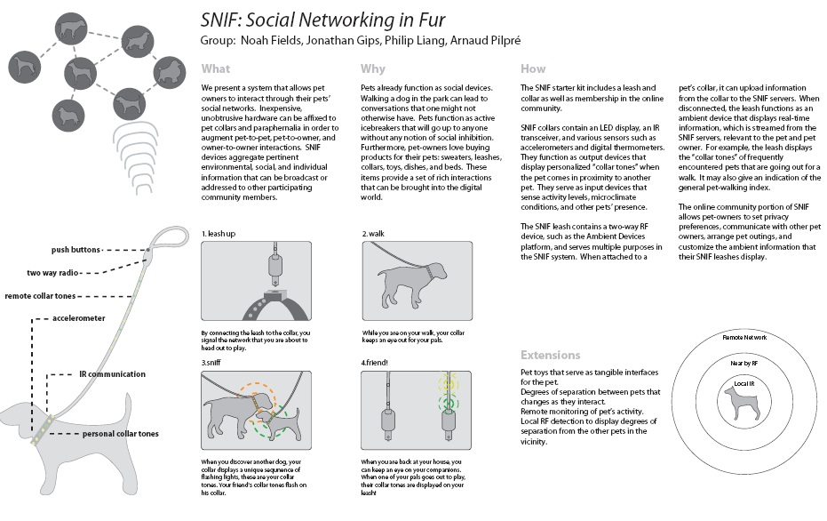
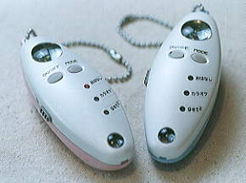


Web Science: An Exploratorium for
Understanding and Enabling Social Networks
Noshir Contractor
Jane S. & William J. White Professor of Behavioral Sciences
Professor of Ind. Engg & Mgmt Sciences, McCormick School of Engineering
Professor of Communication Studies, School of Communication &
Professor of Management & Organizations, Kellogg School of Management,
Director, Science of Networks in Communities (SONIC) Research Laboratory
nosh@northwestern.edu
Supported by NSF : OCI-0753047, IIS-0729505, IIS-0535214, SBE-0555115
SONIC
Advancing the Science of Networks in Communities

Slide 2
Key Takeaways
Web Science is well poised to make a quantum intellectual leap by facilitating collaboration that leverages recent advances in:
  Theories: Theories about the social motivations for creating, maintaining, dissolving and re-creating links in multidimensional networks. Generative mechanisms for emergence of macro-structures.
  Data: Developments in Semantic Web/Web 2.0 provide the technological capability to capture, store , merge, and query relational metadata needed to more effectively understand and enable communities.
  Methods: An ensemble of qualitative and quantitative methods (exponential random graph modeling (p*) techniques to understand and enable theoretically grounded network recommendations
  Computational infrastructure: Cloud computing and petascale applications are critical to face the computational challenges in analyzing the data
SONIC
Advancing the Science of Networks in Communities

Slide 3
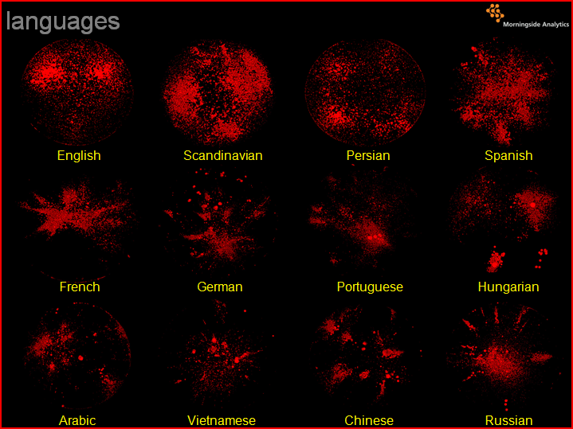
Emergent Structures in the Blogosphere
by Language
SONIC
Advancing the Science of Networks in Communities
Source; John Kelly

Slide 4
WHAT ARE THE GENERATIVE MECHANISMS
THAT EXPLAIN
THE EMERGENT STRUCTURES
OBSERVED IN LARGE SCALE NETWORKS?
WEB SCIENCE PROCESS MODEL
SONIC
Advancing the Science of Networks in Communities

Slide 5
Generative Mechanisms:
Why do we create and sustain networks?
Theories of self-interest
Theories of social and resource exchange
Theories of mutual interest and collective action
Theories of contagion
Theories of balance
Theories of homophily
Theories of proximity
Theories of co-evolution
Sources:
Contractor, N. S., Wasserman, S. & Faust, K. (2006). Testing multi-theoretical multilevel hypotheses about organizational networks: An analytic framework and empirical example. Academy of Management Review.
Monge, P. R. & Contractor, N. S. (2003). Theories of Communication Networks. New York: Oxford University Press.
SONIC
Advancing the Science of Networks in Communities

Slide 6
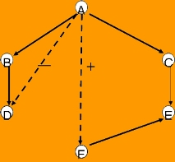
“Structural signatures”
Theories of Self interest
Theories of Exchange
Theories of Balance
A
B
-
+
F
C
E
D
Novice
Expert
Theories of Collective Action
Theories of Homophily
Theories of Cognition
SONIC
Advancing the Science of Networks in Communities

Slide 7
Statistical “MRI” for Structural Signatures
p*/ERGM: Exponential Random Graph Models
Statistical “Macro-scope” to detect structural motifs in observed networks
Move from exploratory to confirmatory network analysis to understand multi-theoretical multilevel motivations for why we create our social networks
SONIC
Advancing the Science of Networks in Communities

Slide 8
A contextual “meta-theory” of
social drivers for creating and sustaining communities
SONIC
Advancing the Science of Networks in Communities

Slide 9
Projects Investigating Social Drivers for Communities
Science Applications
CI-Scope: Understanding & Enabling CI in Virtual Communities (NSF)
CP2R: Collaboration for Preparedness,
Response & Recovery (NSF)
TSEEN: Tobacco Surveillance
Evaluation & Epidemiology
Network (NSF, NIH, CDC)
Business Applications
PackEdge Community of
Practice (P&G)
Kraft Design Teams
Core Research
Socio-technical Drivers for
Creating & Sustaining
Communities
Societal Justice Applications
Cultural & Networks Assets
In Immigrant Communities
(Rockefeller Program on
Culture & Creativity)
Mapping Digital Media and Learning Networks
(MacArthur Foundation)
Entertainment Applications
Second Life (NSF, Army Research Institute, Linden Labs)
EverQuest II (NSF, Army Research Institute, Linden Labs)
SONIC
Advancing the Science of Networks in Communities

Slide 10
Contextualizing Goals of Communities
Challenges of empirically testing, extending, and exploring theories about networks … until now
SONIC
Advancing the Science of Networks in Communities

Slide 11
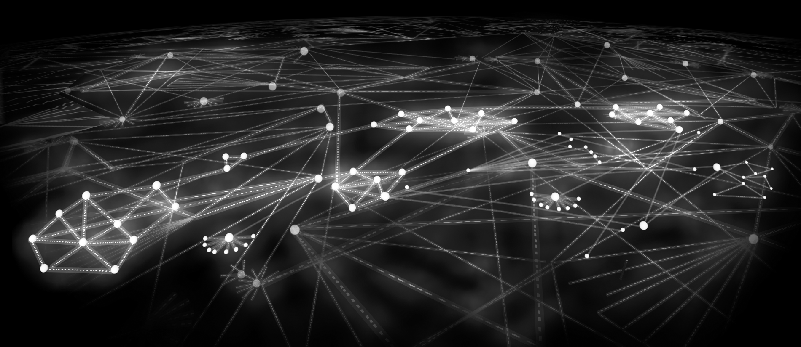
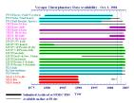
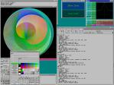




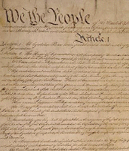
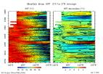




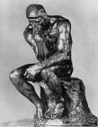











Multidimensional Networks in the Semantic Web/Web 2.0
Multiple Types of Nodes and Multiple Types of Relationships
SONIC
Advancing the Science of Networks in Communities
Notes:
11

Slide 12
Its all about “Relational Metadata”
Technologies that “capture” communities’ relational meta-data (Pingback and trackback in interblog networks, blogrolls, data provenance)
Technologies to “tag” communities’ relational metadata (from Dublin Core taxonomies to folksonomies (‘wisdom of crowds’) like
  Tagging pictures (Flickr)
  Social bookmarking (del.icio.us, LookupThis, BlinkList)
  Social citations (CiteULike.org)
  Social libraries (discogs.com, LibraryThing.com)
  Social shopping (SwagRoll, Kaboodle, thethingsiwant.com)
  Social networks (FOAF, SIOC, SocialGraph)
Technologies to “manifest” communities’ relational metadata (Tagclouds, Recommender systems, Rating/Reputation systems, ISI’s HistCite, Network Visualization systems)
SONIC
Advancing the Science of Networks in Communities
Notes:
Social bookmark managers such as Del.icio.ous (http://del.icio.us), unalog (http://unalog.com),
BlinkList (http://www.blinklist.com), Connectedy (http://www.connectedy.com) or GiveALink
(http://givealink.org) support the collection, categorization and sharing of web linkages. Flickr
(http://www.flickr.com) supports the collection, sharing, and tagging of photos. Common to all of them is
the importance of tags to create folksonomies. Folksonomy is a portmanteau word combining ‘folk’ and
‘taxonomy’. It refers to the organization of knowledge based on tags attached by thousands of users to
millions of records. It is a rather decentralized form of classification that uses the ‘wisdom of crowds’ to
classify records. Folksonomies are typically displayed as list of most commonly used tags.
Tagclouds The text font type, color, and size are frequently used to indicate the number of records that have this tag, the novelty of a tag, activity bursts for the usage of a tag, etc.

Slide 13
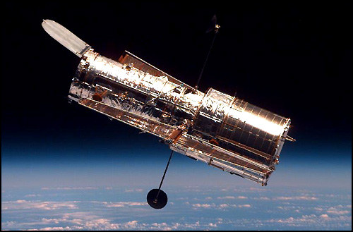
The Hubble telescope: $2.5 billion
SONIC
Advancing the Science of Networks in Communities
Source: David Lazer

Slide 14
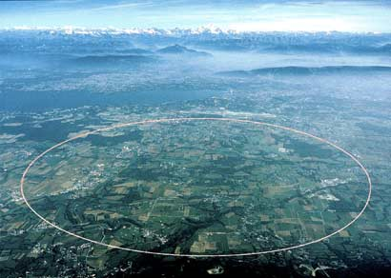
CERN particle accelerator: $1 billion/year
SONIC
Advancing the Science of Networks in Communities
Source: David Lazer

Slide 15
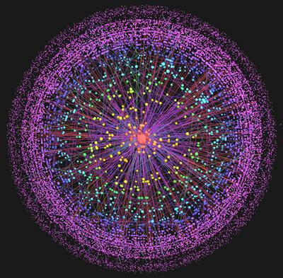

The Web: priceless*
* Apologies to MasterCard
SONIC
Advancing the Science of Networks in Communities
Source: David Lazer

Slide 16
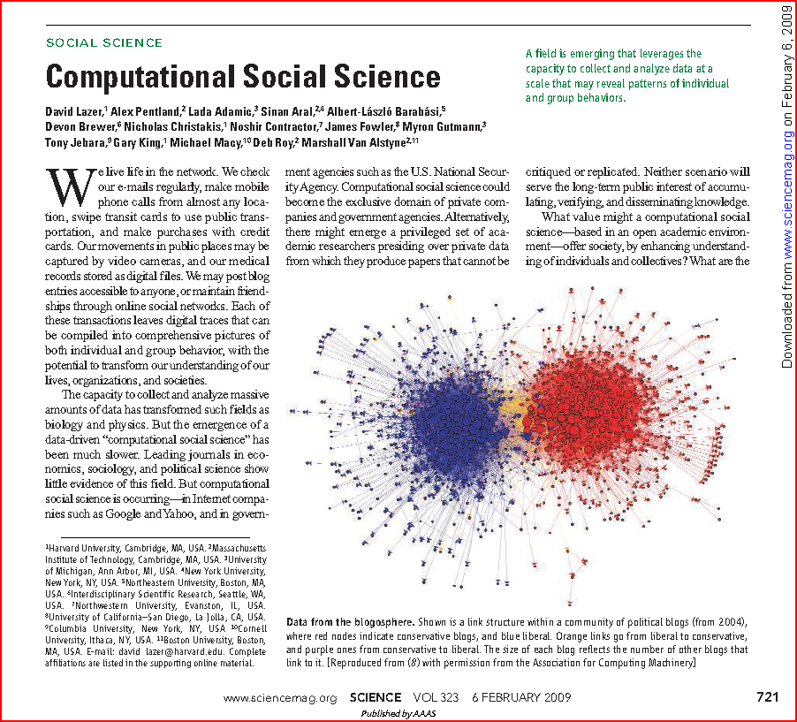
SONIC
Advancing the Science of Networks in Communities

Slide 17

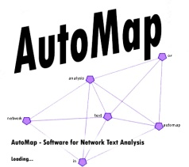
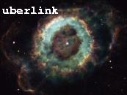



Digital Harvesting of Relational Metadata
Bios, titles & descriptions
Web of Science Citation
Personal Web sites Google search results
CATPAC
UBERLINK
CI-KNOW Analyses and Visualizations
SONIC
Advancing the Science of Networks in Communities

Slide 18
Projects Investigating Social Drivers for Communities
Science Applications
CI-Scope: Understanding & Enabling CI in Virtual Communities (NSF)
CP2R: Collaboration for Preparedness,
Response & Recovery (NSF)
TSEEN: Tobacco Surveillance
Evaluation & Epidemiology
Network (NSF, NIH, CDC)
Business Applications
PackEdge Community of
Practice (P&G)
Kraft Design Teams
Core Research
Socio-technical Drivers for
Creating & Sustaining
Communities
Societal Justice Applications
Cultural & Networks Assets
In Immigrant Communities
(Rockefeller Program on
Culture & Creativity)
Mapping Digital Media and Learning Networks
(MacArthur Foundation)
Entertainment Applications
Second Life (NSF, Army Research Institute, Linden Labs)
EverQuest II (NSF, Army Research Institute, Linden Labs)
SONIC
Advancing the Science of Networks in Communities

Slide 19
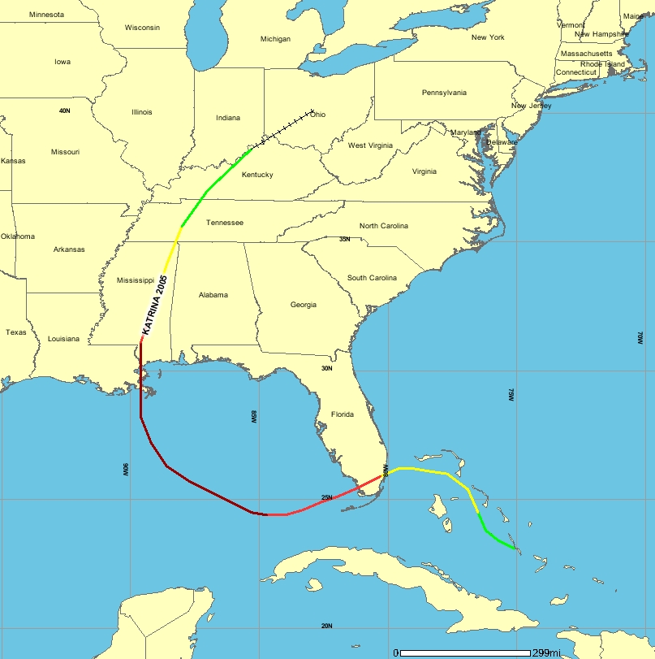
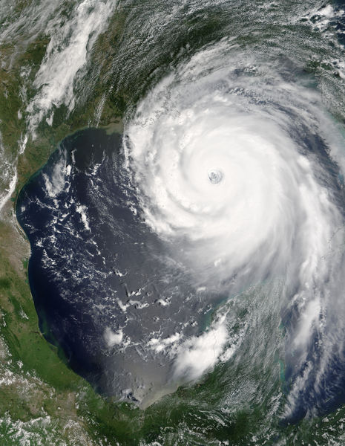
Hurricane Katrina 2005
Formed: Aug 23, 2005
Dissipated: Aug 31, 2005
Highest wind: 175 mph
Lowest press: 902 mbar
Damages: $81.2 Billion
Fatalities: >1,836
Areas affected: Bahamas,
South Florida, Cuba, Louisiana (especially Greater New Orleans), Mississippi, Alabama, Florida Panhandle, most of eastern North America
8/31
8/30
8/29
8/28
8/25
8/27
8/26
8/24
8/23
SONIC
Advancing the Science of Networks in Communities
Map source: http://hurricane.csc.noaa.gov/
Notes:
Overview of Hurricane Katrina. Disasters require coordination, coordination between organizations is not always according to plan (Carter’s Port Authority Police radio paper). Therefore, the structure of the communication is important for the proper actions during a disaster Analyzing the structure during an actual disaster can detect problems and solutions can be developed in real time (This is yet to be done).
Trivia note: How may storms/hurricane have been named Katrina? 6 (1967, 1971, & 1975 in the Pacific; 1981, 1999, & 2005 in the Atlantic)

Slide 20
SITREP Content
Basic Format / Information
  Situation (What, Where, and When)
  Action in Progress
  Action Planned
  Probable Support Requirements and/or Support Available
  Other items
SONIC
Advancing the Science of Networks in Communities
Notes:
SITREPs are Situation Reports that are written by lower or on site commands to report the situation to those higher up. They should all contain this basic information and in this basic format.

Slide 21
Typical SITREP
*Colorado Division of Emergency Management
SITUATION REPORT 2005-6
(Hurricane Katrina)
August 30, 2005*
*Event Type:* Hurricane Response
*Situation:* On August 29, Hurricane Katrina hit the gulf coast east of New
Orleans. It was considered a Category 5 Hurricane, which brings winds of
over 155mph and storm surge of 18 feet above normal. Massive property damage
has occurred and undetermined number of deaths and injuries.
Colorado response to date include two deployments:
- Two members from the Division of Emergency Management to the Louisiana
EOC, departed on August 29.
· · ·
*Weather Report:* Katrina is moving toward the north-northeast near 18 mph.
A turn toward the northeast and a faster forward speed is expected during
the next 24 hours. This motion should bring the cent
· · ·
*Agencies Involved:* Colorado Department of Military and Veteran Affairs,
Department of Local Affairs, Division of Emergency Management, Governor's
Office.* *
*Additional Assistance Requested:* Type III teams, consisting of Operations,
Plans, and Logistics personnel (two individuals for each area). These teams
could deploy to Alabama, Louisiana, and/or Mississippi. Teams will be
at either working the State or Parish/County EOCs.
· · ·
SONIC
Advancing the Science of Networks in Communities
Notes:
Here is an example SITREP excerpt from the data set used in analysis. This is from the Colorado Division of Emergency Management and has the basic information per the previous slide (i.e., Situation, Action in progress, Probable support requirements).

Slide 22
Human Coding Procedure
Using an HTML editor to mark entities (people, organizations, locations, concepts)
  as bold and include a unique HTML tag
  <b><a name=“F10005505a00003”></a>FEMA</b>
SONIC
Advancing the Science of Networks in Communities
Notes:
Human coding procedure from the coding document that the UCI group sent.
Automatically tagged F10005505a id of the sitrep 00003 is the id
Example of over coding 1 truckload of pedia care (saline drink for children)

Slide 23
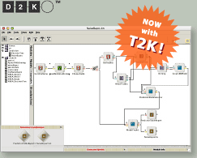
Automatic Coding
D2K – The Data to Knowledge application environment is a rapid, flexible data mining and machine learning system
Automated processing is done through creating itineraries that combine processing modules into a workflow
Developed by the
Automated Learning
Group at NCSA
SONIC
Advancing the Science of Networks in Communities
Notes:
Basic description of D2K.

Slide 24
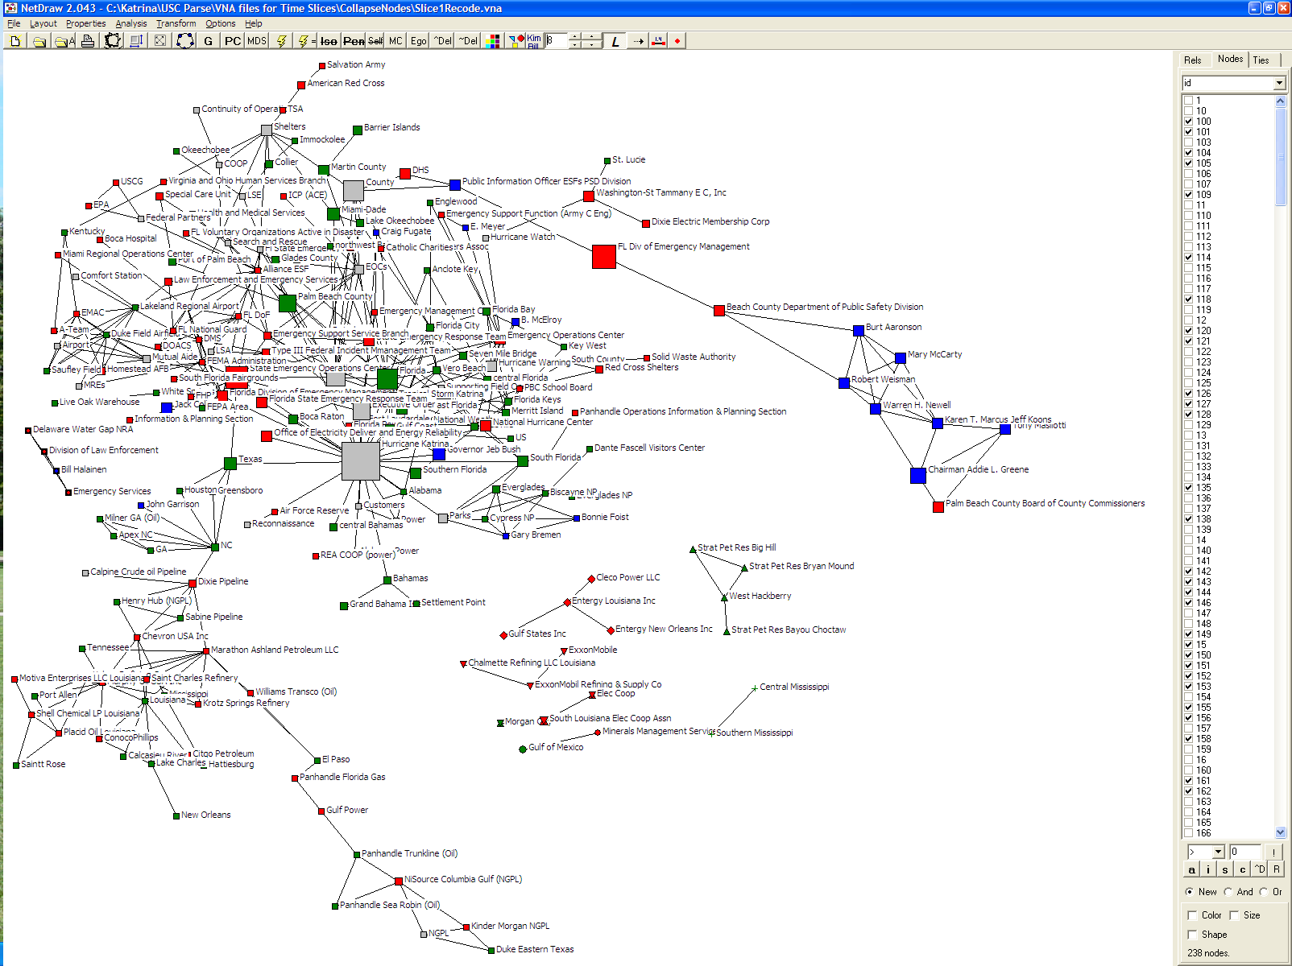
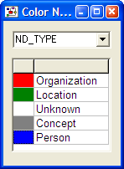
Time Slice 1: 8/23 to 8/25/2005
SAL
Florida is the Topic
of the Conversation
ARC
Shelter
KY
FEMA
FL
TX
Gov Bush
AL
Petroleum Network
formed Early
LA
SONIC
Advancing the Science of Networks in Communities
NO
Notes:
Time Slice 1 with Concepts. American Red Cross on the top. FEMA only exist at FEMA Administration (Middle Left). Florida and Palm Beach are big here (many mentions). Note the Oil and Power groupings on the bottom. There is also a pocket of National Parks in the middle. Location are heavily based in Florida except the Petroleum Network. Note that New Orleans is on the fringe at the bottom.

Slide 25
Time Slice 1 to 2
SAL
ARC
Shelter
KY
GA
Power
FEMA
FP&L
FL
TX
Gov Bush
AL
Military
LA
SONIC
Advancing the Science of Networks in Communities
NO

Slide 26
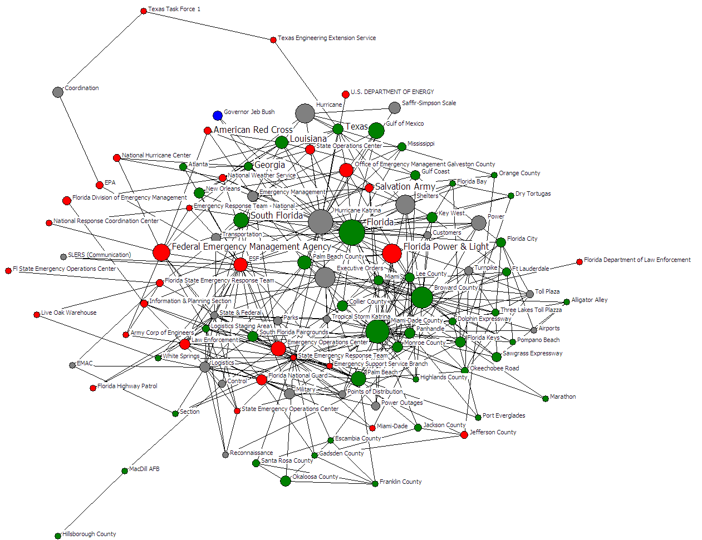
Time Slice 2: 8/26 to 8/27/2005
Gov Bush
TX
ARC
LA
MS
GA
NO
SAL
Shelter
FL
Power
FEMA
FP&L
Military
SONIC
Advancing the Science of Networks in Communities
Notes:
Slice 2: Nodes mentioned at least 4 times or more: This the increased mentions of other states and many Florida counties. FEMA is moving out from the center and American Red Cross is moving in. Petroleum nodes have faded. There seem to be a lot of travel related nodes (toll road, turnpike, expressway, etc. – Evacuation?). New Orleans is moving towards the middle of the network from the fringe.

Slide 27
Time Slice 2 to 3
Gov Bush
ARC
TX
LA
MS
NO
GA
SAL
Power
Shelter
NC
FL
FEMA
FP&L
Military
SONIC
Advancing the Science of Networks in Communities

Slide 28
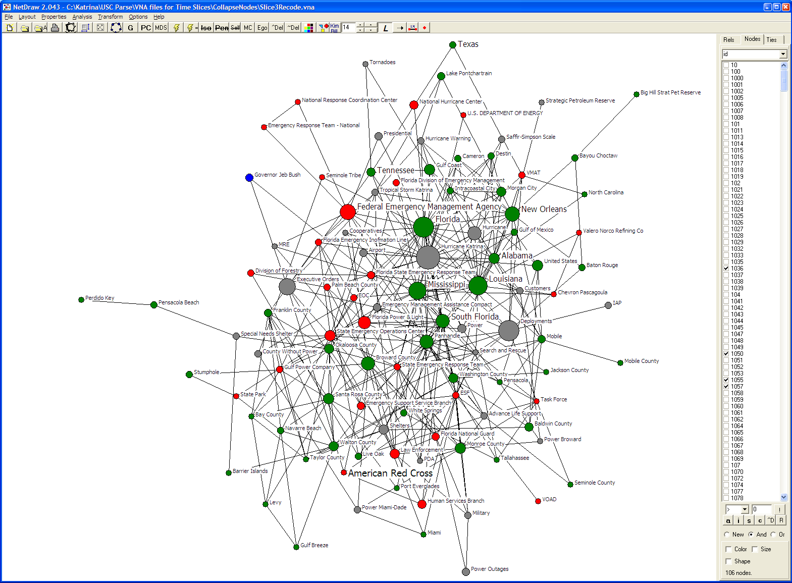
Time Slice 3: 8/28 to 8/29/2005
TX
GA
Gov Bush
FEMA
NC
NO
FL
MS
LA
FP&L
Power
Shelter
ARC
Military
SONIC
Advancing the Science of Networks in Communities
Notes:
Slice 3: One large component of nodes of frequency 4 or higher (i.e., mentioned at least four times). It looks like more states are being mentioned (and cites/counties in those states). FEMA is getting larger and with about the same centrality. American Red Cross is at 7 o’clock and becoming more central. Governor Bush is moving out of the center (as he did in the last slice, 1st slice he was in the center). New Orleans is at about the same distance from the center. There is an oil grouping on the right (1 o’clock), but it is discussing the Strategic Petroleum Reserve. Florida Power and Light is prominent just left of center (getting power back to Florida customers); there are power related concepts throughout the network.

Slide 29
Time Slice 3 to 4
TX
AL Power
National Guard
GA
Gov Bush
FEMA
NC
NO
FL
AL
MS
LA
FP&L
Power
S & R
Shelter
ARC
Military
SONIC
Advancing the Science of Networks in Communities

Slide 30
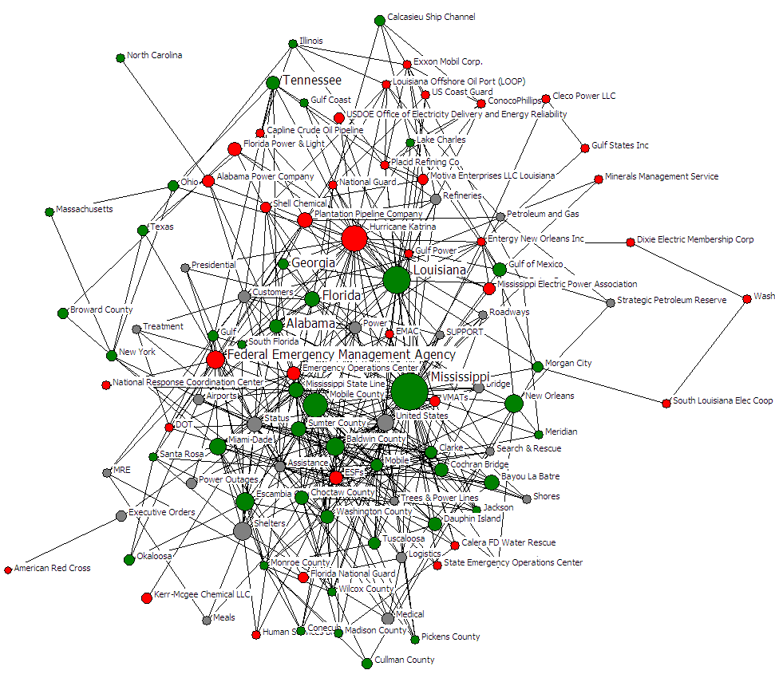
Time Slice 4: 8/30 to 8/31/2005
NC
FP&L
AL Power
National Guard
TX
GA
LA
FL
AL
Power
FEMA
MS
NO
S & R
Shelter
ARC
SONIC
Advancing the Science of Networks in Communities
Notes:
Slice 4:Nodes Mentioned 6 or more times. Other states are gaining prominence over Florida (Mississippi and Louisiana). American Red Cross has move out of the center (just this slice – they will move back later), this is consistent with the Network Centrality Graph. FEMA is also moving into the center this slice. There is a lot oil an energy concerns here. Shelters, MRE (meals ready to eat), and Power are key concepts – Alabama Power has join with Florida Light and Power (FL&P). Search and Rescue is showing up (S&R). The National Guard has joined the network.

Slide 31
Time Slice 4 to 5
FP&L
NC
AL Power
National Guard
TX
GA
LA
FL
AL
Power
FEMA
MS
NO
S & R
Shelter
ARC
SONIC
Advancing the Science of Networks in Communities

Slide 32
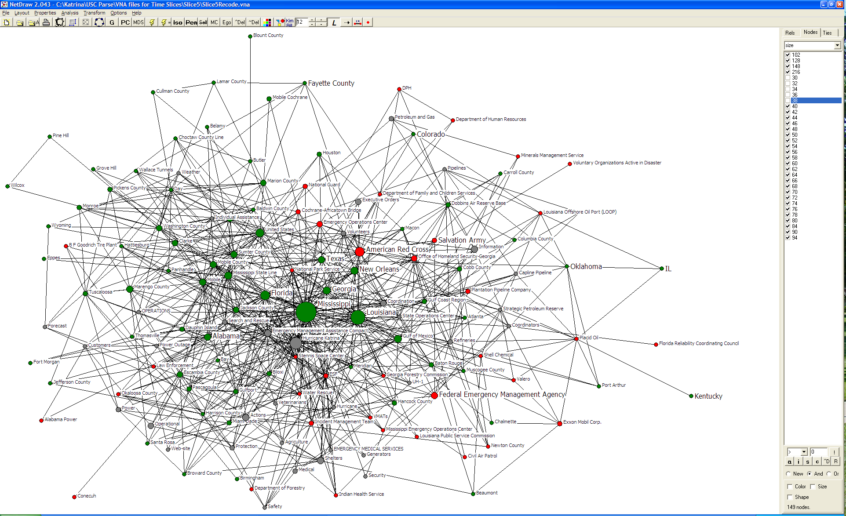
Time Slice 5: 9/1 to 9/2/2005
NC
National Guard
TX
ARC
NO
FL
GA
S & R
MS
LA
AL
FEMA
AL Power
Power
Shelter
SONIC
Advancing the Science of Networks in Communities
Notes:
Slice 5:Nodes Mentioned 6 or more times. Florida Power has left the network, Alabama power remains but is at the outer edge of the network (with the concept of Power). The National Guard is maintaining position. The American Red Cross as moved in and FEMA has moved out. Shelter is moving to the margin.

Slide 33
Time Slice 5 to 6
National Guard
TX
ARC
NO
FL
GA
S & R
MS
LA
AL
FEMA
AL Power
Power
Shelter
SONIC
Advancing the Science of Networks in Communities

Slide 34
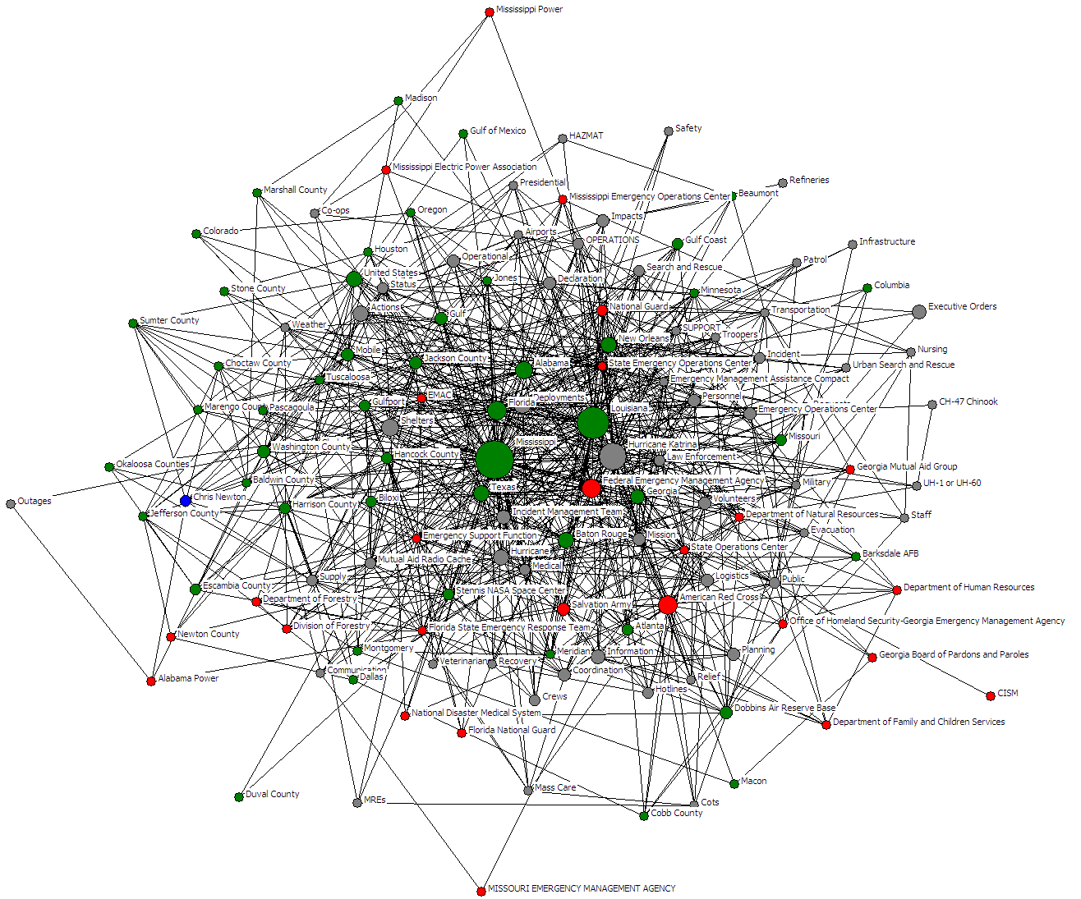
Time Slice 6: 9/3 to 9/4/2005
S & R
National Guard
NO
AL
Urban S & R
Shelter
FL
LA
MS
FEMA
Outages
TX
GA
ARC
AL Power
SONIC
Advancing the Science of Networks in Communities
Notes:
Slice 6:Nodes Mentioned 6 or more times. Mississippi and Louisiana are the most frequent states mentioned. Urban Search and Rescue has joined the network as a key concept – Power has changed to Outages and AL Power is at the margin still. Shelter has moved back to the middle of the network (is this gaining importance as New Orleans is evacuated?).. FEMA and ARC have essentially swapped positions and the National Guard is moving towards the center. {Chris Newton shows up here at the 9 o’clock position – blue dot (the only person since Gov Bush faded in slice 4), but this is an artifact of the SITREP sources in the later slices having briefing announcements about roads that Chris is giving.}

Slide 35
Change in Network Centrality Rankings
“American Red Cross” starts in the 200s and moves to the teens
“FEMA” starts in the 20s, moves to the teens, and ends in the 60s
Crossover where American Red Cross becomes relatively more central than FEMA (Sep 1, 2005)
SONIC
Advancing the Science of Networks in Communities
FEMA drops rank and American Red Cross moves up
Notes:
This slide gives some trend information on two players in the disaster: FEMA and ARC. It is interesting that FEMA starts low and moves up, while the Red Cross starts high and ends low: are they trading roles or emphasis: FEMA manages the emergency, and Red Cross coordinates the recovery?

Slide 36
Projects Investigating Social Drivers for Communities
Science Applications
CI-Scope: Understanding & Enabling CI in Virtual Communities (NSF)
CP2R: Collaboration for Preparedness,
Response & Recovery (NSF)
TSEEN: Tobacco Surveillance
Evaluation & Epidemiology
Network (NSF, NIH, CDC)
Business Applications
PackEdge Community of
Practice (P&G)
Kraft Design Teams
Core Research
Socio-technical Drivers for
Creating & Sustaining
Communities
Societal Justice Applications
Cultural & Networks Assets
In Immigrant Communities
(Rockefeller Program on
Culture & Creativity)
Mapping Digital Media and Learning Networks
(MacArthur Foundation)
Entertainment Applications
Second Life (NSF, Army Research Institute, Linden Labs)
EverQuest II (NSF, Army Research Institute, Linden Labs)
SONIC
Advancing the Science of Networks in Communities

Slide 37
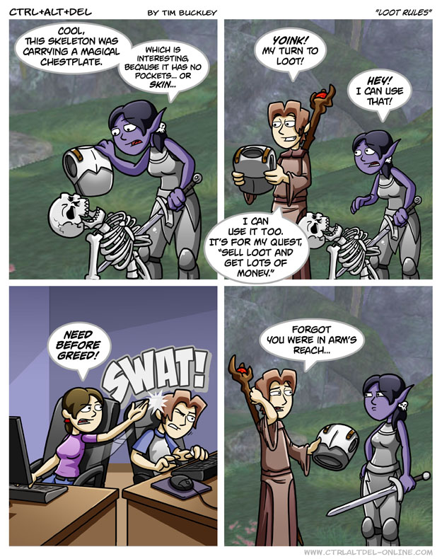
Online and Offline
SONIC
Advancing the Science of Networks in Communities
Notes:
37

Slide 38
Four Types of Relations in EQ2
Partnership: Two players play together in combat activities;
Instant messaging: Two players exchange messages through Sony universal chat system
Player trade: Players meet “face-to-face” in EQ2 and one gives items to another;
Mail: One player sends a message and/or items to others by in-game mail
 | Synchronous | Asynchronous
Interpersonal interaction | Partnership, Instant messaging
Transactional interaction | Player trade | Mail
SONIC
Advancing the Science of Networks in Communities
Notes:
38

Slide 39
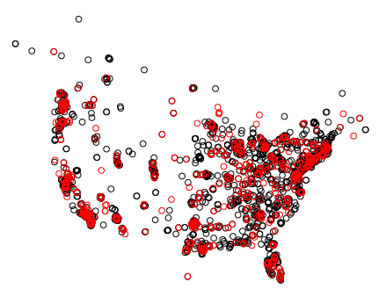
Data Description
3140 players from Aug 25 to Aug 31 2006, in Antonia Bayle
  2998 US, 142 CA ; 2447 male, 693 female
Demographic information
  Gender, age, and account age (years played Sony games)
  Zip code, state, and country
SONIC
Advancing the Science of Networks in Communities
Notes:
Focus on players in the U.S. and Canada
Female: Red; Male: black
39

Slide 40
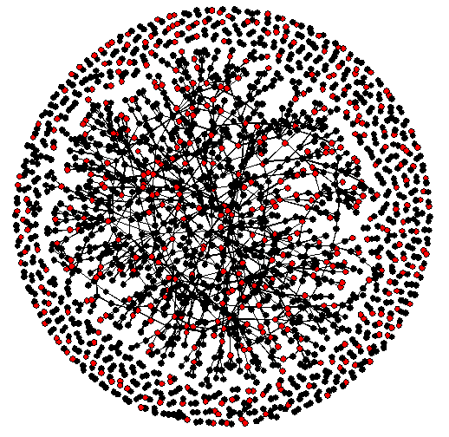
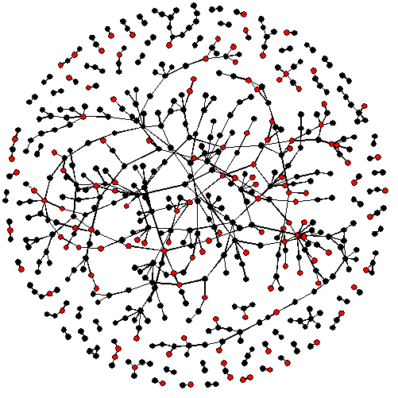
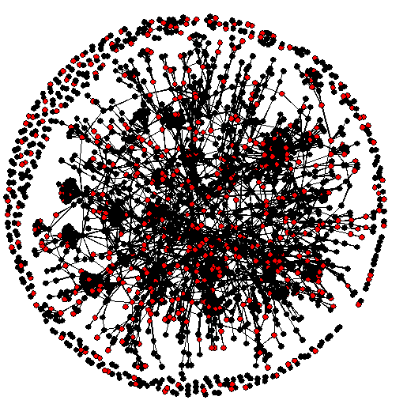
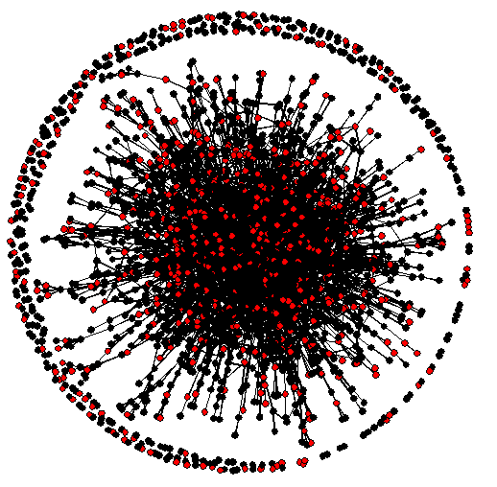
Black: male
Red: female
Partnership
Instant messaging
SONIC
Advancing the Science of Networks in Communities
Trade
Mail
Notes:
40

Slide 41
Results
Selectivity and transitivity (friend of a friend) exists in all online relations.
Homophily of age and game experience is supported in all four relations.
Distance matters but short distances are more important. Individuals living within 50 Km are 22.6 times more likely to be partners than those who live between 50 and 800 Km.
Time zones impacts gaming and trading but not IM and mail. Individuals in the same time zone are 1.25 times more likely to be game partners than the individuals with one hour difference (but no time zone effect for
Gender homophily is not supported for all relations and female players are more likely to interact with the male players.
SONIC
Advancing the Science of Networks in Communities
Notes:
41

Slide 42
Projects Investigating Social Drivers for Communities
Science Applications
CI-Scope: Understanding & Enabling CI in Virtual Communities (NSF)
CP2R: Collaboration for Preparedness,
Response & Recovery (NSF)
TSEEN: Tobacco Surveillance
Evaluation & Epidemiology
Network (NSF, NIH, CDC)
Business Applications
PackEdge Community of
Practice (P&G)
Kraft Design Teams
Core Research
Socio-technical Drivers for
Creating & Sustaining
Communities
Societal Justice Applications
Cultural & Networks Assets
In Immigrant Communities
(Rockefeller Program on
Culture & Creativity)
Mapping Digital Media and Learning Networks
(MacArthur Foundation)
Entertainment Applications
Second Life (NSF, Army Research Institute, Linden Labs)
EverQuest II (NSF, Army Research Institute, Linden Labs)
SONIC
Advancing the Science of Networks in Communities

Slide 43
Friendship in Second Life Teen Grid
Teen Second Life
  An international gathering place for teens 13-17 to make friends and to play, learn and create.
All active players in the second quarter in 2007
  2,456 users and 21,232 friendship
Do Homophily and Proximity still apply?
SONIC
Advancing the Science of Networks in Communities

Slide 44
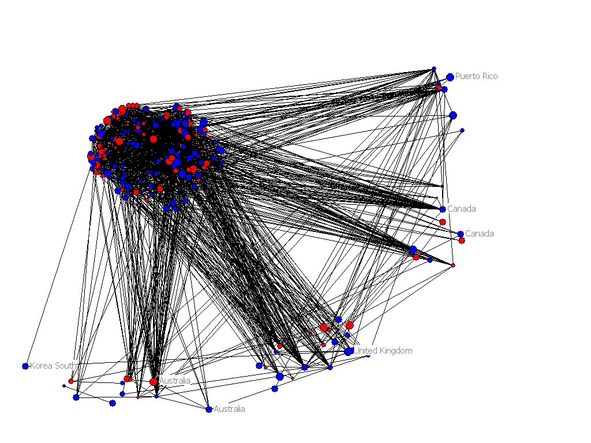
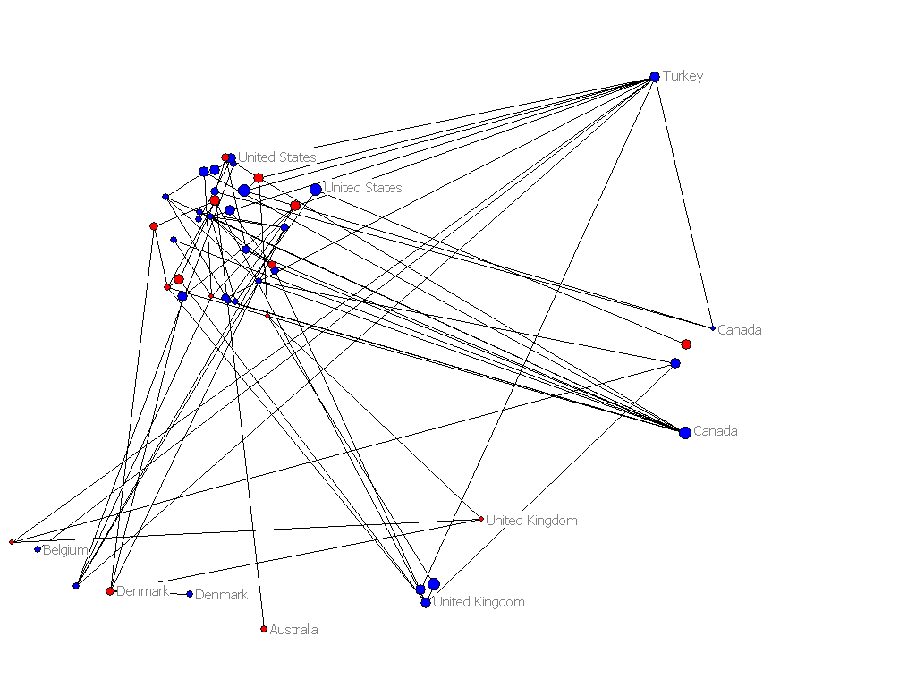
Male
Female
Size indicates age
SONIC
Advancing the Science of Networks in Communities

Slide 45
Hypotheses Tested
H1: Friendship ties are not random.
H2: Geographic proximity is positively associated with friendship formation.
H3: Digital proximity (time spent online) is positively associated with friendship formation.
H4: Temporal proximity (joining at similar times) is positively associated with friendship formation.
H5: Age homophily are more likely to form friendships (though not very strong)
H6: Friendships tend to be balanced (friend of a friend).
SONIC
Advancing the Science of Networks in Communities

Slide 46
Tobacco Research: TobIG Demo
Computational Nanotechnology: nanoHUB Demo
Cyberinfrastructure: CI-Scope Demo
Oncofertility: Onco-IKNOW
From Understanding to Enabling Networks in …
SONIC
Advancing the Science of Networks in Communities

Slide 47
Summary
Web Science is well poised to make a quantum intellectual leap by facilitating collaboration that leverages recent advances in:
  Theories: Theories about the social motivations for creating, maintaining, dissolving and re-creating links in multidimensional networks
  Data: Developments in Semantic Web/Web 2.0 provide the technological capability to capture, store and query relational metadata needed to more effectively understand and enable communities.
  Methods: Ensemble of qualitative and quantitative methods (exponential random graph modeling (p*) techniques) enable theoretically grounded network recommendations
  Computational infrastructure: Cloud computing and petascale applications are critical to face the computational challenges in analyzing the data
SONIC
Advancing the Science of Networks in Communities

Slide 48








Acknowledgements
SONIC
Advancing the Science of Networks in Communities

Slide 49
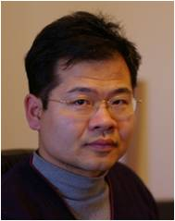
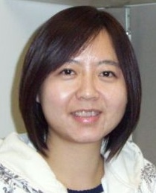
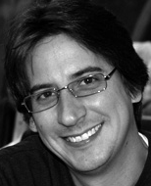




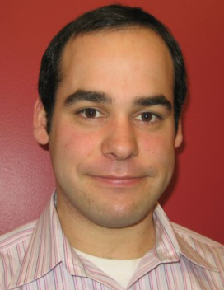

SONIC Team
Yun Huang Annie Wang David Huffaker
Post-doc Post-doc Doctoral candidate
York Yao
Research Programmer
Brian Keegan
Doctoral Candidate
Mengxiao Zhu Jingling Li Jeffrey Treem
Doctoral candidate Research Programmer Doctoral candidate
Zack Johnson
Undergraduate
SONIC
Advancing the Science of Networks in Communities
Notes:
Pis?

